Slide 1
Research
  Phenomenological investigation of fracture dynamics in 3D
  Integrate fracture dynamics in reservoir simulation
Remarks
  Geomechanics effects are often analyzed with more complexity than necessary for conventionals
  Need an application where geomechanics is relevant and cannot be handled by linear tables for porosity/permeability or plane strain simulation
Application ideas
  Non-isothermal water/gas injection in carbonates (NFR)
  Fracture propagation and fluid containment with salt as caprock
PAPER RECOMMENDATION: SPE219461

Slide 2
Strategy
  develop simulation routines gradually
  find intermediate applications for valitation and maturing
Starting point
  The elastic homogenization application we are working on
Where we are
  Validation went through
  Mesh generator used to work …
Next step
  Generate meshes
  Run simples testcases

Slide 3
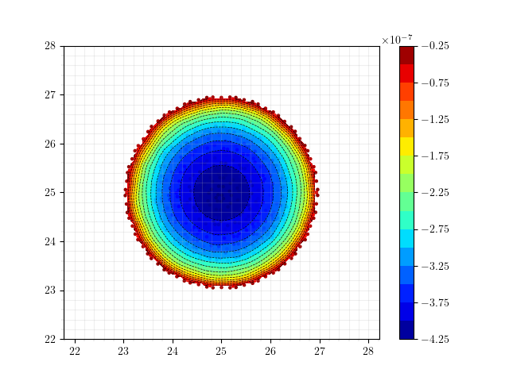
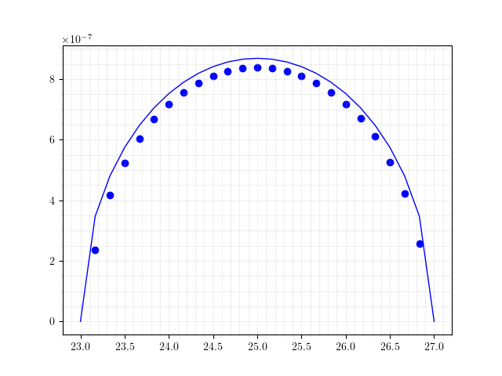
SNEDDON, COARSE MESH
Book (VALKO, ECONOMIDES)
Mesh Information:
elem_dimensions()={3}
spatial_dimension()=3
n_nodes()=13086
n_local_nodes()=3829
n_elem()=9138
n_local_elem()=2285
n_active_elem()=9138
Time: 10s
Maximum UZ displacement: 4.1952e-07
WMAX: 4.3450e-07
ERR: -3.45 %

Slide 4
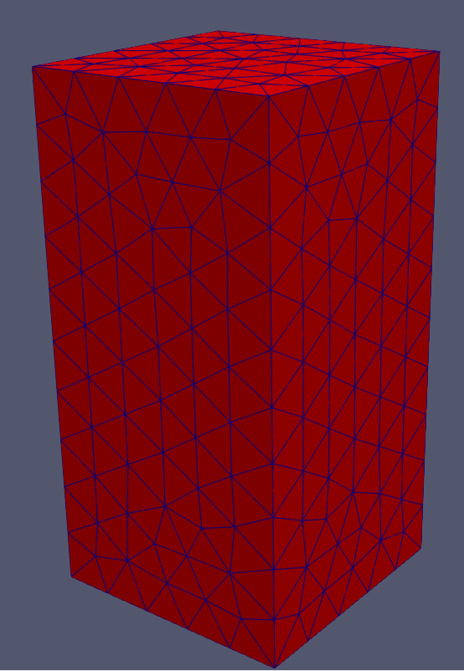
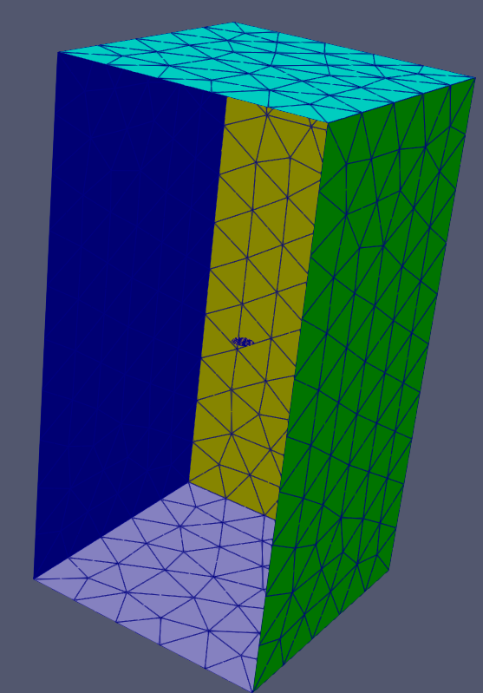
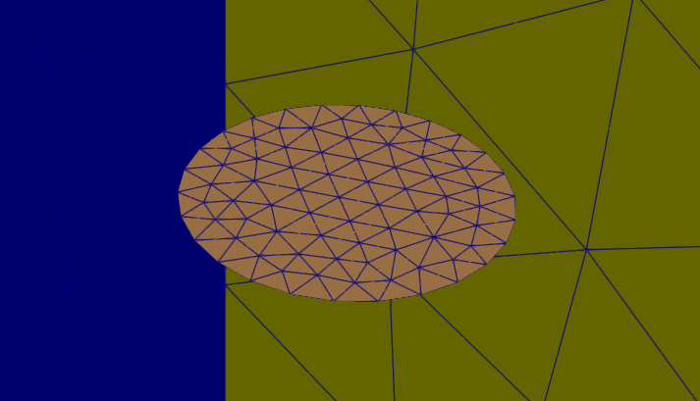
SNEDDON, COARSE MESH
ISOGEOMETRIC ANALYSIS?
Mesh Information:
elem_dimensions()={3}
spatial_dimension()=3
n_nodes()=13086
n_local_nodes()=3829
n_elem()=9138
n_local_elem()=2285
n_active_elem()=9138
Time: 10s
Maximum UZ displacement: 4.1952e-07
WMAX: 4.3450e-07
ERR: -3.45 %

Slide 5
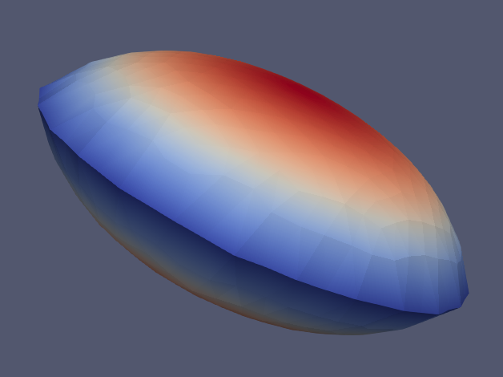
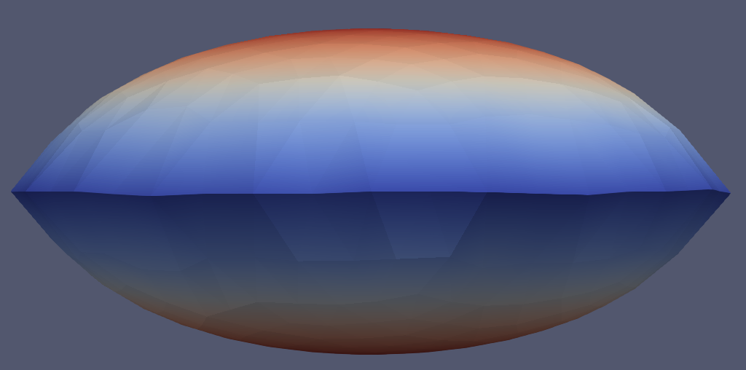
SNEDDON, COARSE MESH
Mesh Information:
elem_dimensions()={3}
spatial_dimension()=3
n_nodes()=13086
n_local_nodes()=3829
n_elem()=9138
n_local_elem()=2285
n_active_elem()=9138
Time: 10s
Maximum UZ displacement: 4.1952e-07
WMAX: 4.3450e-07
ERR: -3.45 %

Slide 6
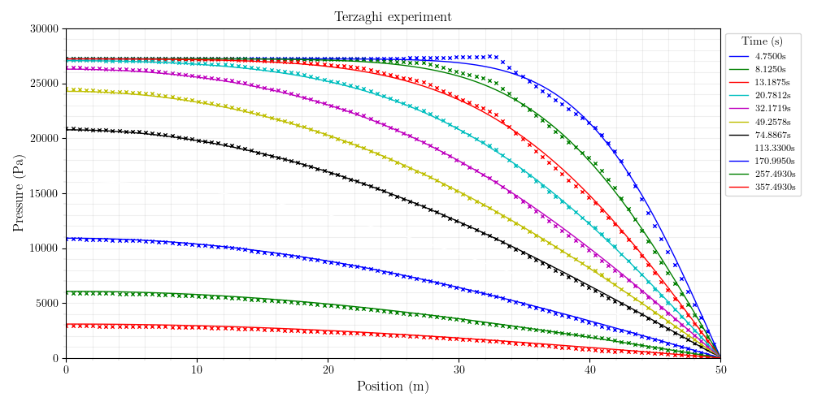
Mesh Information:
elem_dimensions()={3}
spatial_dimension()=3
n_nodes()=1798
n_local_nodes()=515
n_elem()=942
n_local_elem()=235
n_active_elem()=942
TERZAGHI, CRANK NICHOLSON (9s)

Slide 7
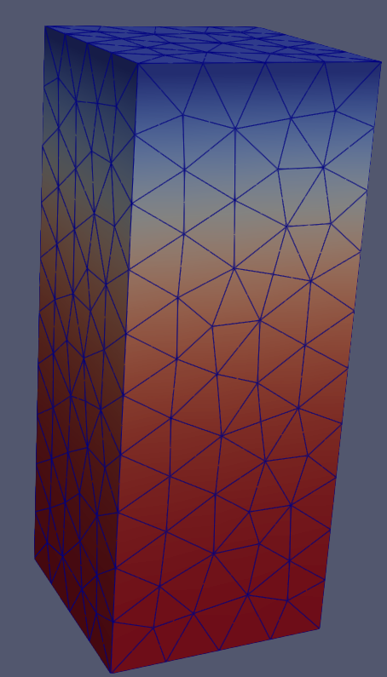
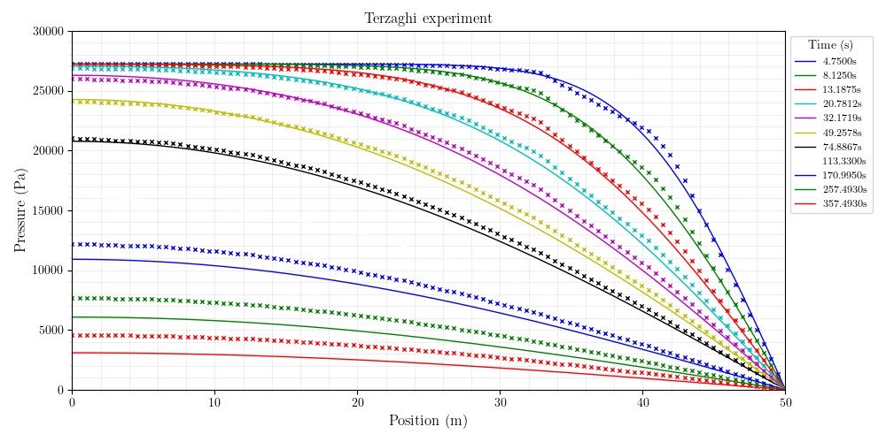
Mesh Information:
elem_dimensions()={3}
spatial_dimension()=3
n_nodes()=1798
n_local_nodes()=515
n_elem()=942
n_local_elem()=235
n_active_elem()=942
TERZAGHI, IMPLICIT

Slide 8
MANDEL – CRANK NICHOLSON

Slide 9
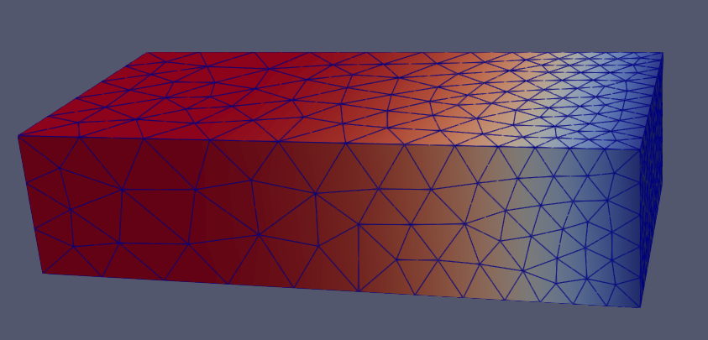
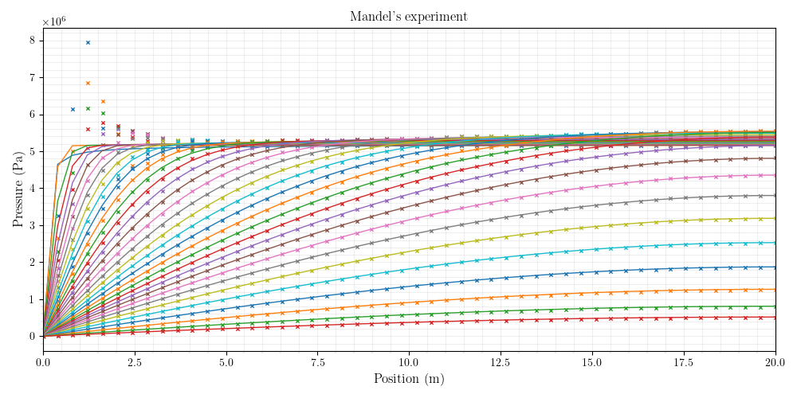
MANDEL – CRANK NICHOLSON
Mesh Information:
elem_dimensions()={3}
spatial_dimension()=3
n_nodes()=3188
n_local_nodes()=858
n_elem()=1756
n_local_elem()=439
n_active_elem()=1756

Slide 10
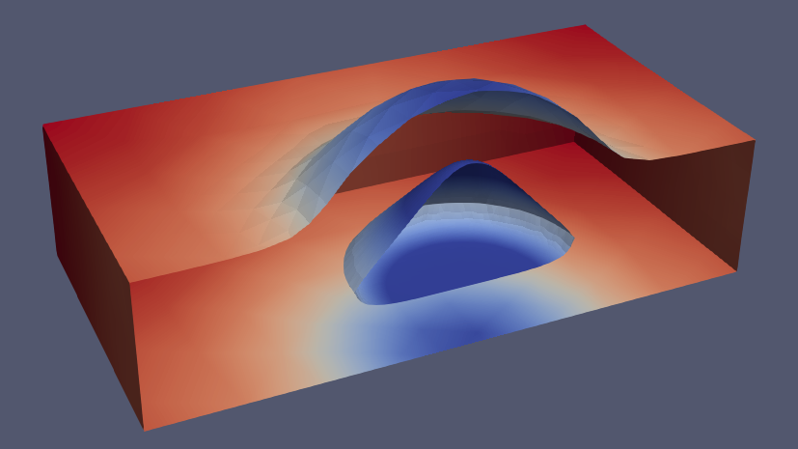
Mesh Information:
elem_dimensions()={3}
spatial_dimension()=3
n_nodes()=18045
n_local_nodes()=4867
n_elem()=12115
n_local_elem()=3028
n_active_elem()=12115
MASS BALANCE
197s

Slide 11
Next
Validate with poroelastic solution of Detournay
PKN model

